Slide 1
Motion and Position

Slide 2
Position describes the location of an object
The position is the location of that place of object.
You often describe the position by comparing its position from where you are
For example, you might say the mailbox is 5 meters south from my front door.

Slide 3
Position
A position is always given compared to an origin.
The origin is a fixed reference point.
For example, when you give directions from your house to the school, your house is the origin

Slide 4
Describing position
Similar to describing a point on a graph or a number line.
The origin is at zero
A positive position is to the right or above the origin
A Negative position is to the left or below the origin.
Think of longitude and latitude on a map

Slide 5
Describing a position

Slide 6
Measuring distance
Start at the origin. Walk 5 m to your left and 9 meters to the right and 2 m to the left. Where are you now
2m
Start at the origin and walk 2m east, 7m west and 6m east. Where are you now?
2m east
Challenge: Walk 10 miles north, 3 miles east, 14 miles south, 2 miles west, 4 miles north and 1 mile west. Where are you now?
Back to the origin

Slide 7
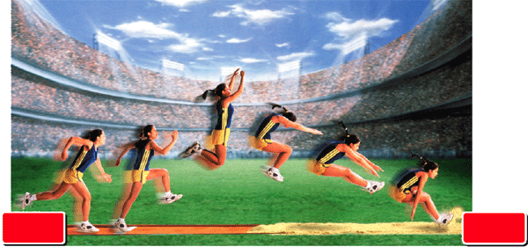
Motion is a change in position
Motion- the change of position over time.
As she jumps both her horizontal and vertical position changes
starting
position
ending
position

Slide 8
Describing motion
A change in an objects position tells you that motion took place, but it does not tell you how quickly the object changed position.

Slide 9
Relative Motion
file:///E:/Animation%20List.html#
position is described by using a reference point
motion is described by using a frame of reference as the location of the observer, who may be in motion.

Slide 10
Relative motion
If you were seated on the train, who or what would be moving compared with you?
Who would be still compared with you?

