Slide 1
Mixtures
Identifying mixtures as homogeneous and heterogeneous

Slide 2
Review
What do you remember about atoms?
- Smallest unit of matter
- The basic building block of matter
- when you break down an element into its simplest form you get an atom

Slide 3
Review
What do you remember about elements?
Pure substances
Can not be broken down
Has its own unique properties
Examples: Nitrogen gas, chlorine gas, sodium, copper and iron

Slide 4
Review
What is a compound
Made of 2 or more elements
Each compound has its own properties which may differ from the elements itself
Can be broken down into simpler substances
Examples: H₂O, NaCl, CO₂

Slide 5
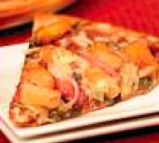
Mixtures
What does it take to make the perfect pizza?
Cheese, crust, veggies, meat.

Slide 6
This creates a mixture: The ingredients are mixed together, but you can separate the ingredients.
(Not the cheese and sauce making a compound or a new substance)
A mixture is: a combination of two or more substances that are not chemically combined

Slide 7
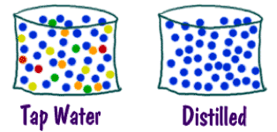
Example of a Mixture: Water
When you see distilled water it’s a pure substance
Water with other things dissolved in it like salt or fluoride
Only water molecules in the liquid

Slide 8
More, more and more examples of mixtures
Air consists of nitrogen, oxygen and other various gases
Seawater or pond water is a mixture of water with other dissolved chemicals such as sodium
Gasoline is a mixture
People are highly complex mixtures made of many different compounds
Medicine, perfume….
You get the idea

Slide 9
Don’t Change me!
Mixtures do not like to change and keep their identity.
No chemical reactions occur and substances are the same before and after you mix them together
You can physically separate the substances, you cannot change them.
If you chemically changed them you would have what kind of molecule____________?

Slide 10
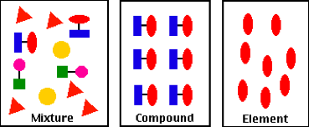
I like to be different and special
Made of different materials
Only two different elements
All the same

Slide 11
Mixture Vs. Compounds
What is the difference between a mixture and a compound?
Think of water, a compound, made up of the elements hydrogen and oxygen.
Not only is water totally different from its elements, but you can’t easily separate the elements in water.

Slide 12
What if you mixed sugar and sand in the water?
The mixture is both sweet (from the sugar) and Gritty (from the sand)
The sugar dissolves, but the sand doesn’t which lets you separate them easily.

Slide 13
Mixtures Vs. Compounds
Mixtures
Compounds
Compounds
KEEP their original properties
LOSE their original properties
Elements
Separated by PHYSICAL
MEANS- FILTERING
Separated by CHEMICAL MEANS-

Slide 14
TWO TYPES OF MIXTURES
1- Homogeneous
Homo= Same
2- Heterogeneous
Hetero= Different

Slide 15
Homogeneous Mixtures
A homogeneous mixture is a uniform mixture made up of the same components.
Examples:
Gases
Solids- you have to know the make up. For example, steel is a mixture of iron and carbon, but you can’t tell them apart.
Liquids- you can see through the liquid
Tea is a homogeneous mixture
Milk is not

Slide 16
Heterogeneous
Mixture made up of different particles
If you can tell that there is more than one thing in a container its heterogeneous
Liquid- if you can’t see through the liquid its heterogeneous
If you can tell there is an easy way to physically separate the different particles, then it’s heterogeneous
For example, chex mix, trail mix, pepper…etc.

Slide 17
Solutions
A solution is a mixture that appears to be a single substance, but is made of particles of 2 or more substances that are evenly distributed among each other.
Solutions are Homogeneous mixtures
Basically- the particles are so well mixed together that the composition is the same throughout and we can’t see the distinct molecules even with a microscope

Slide 18
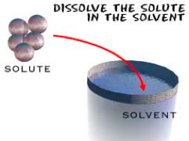
Solutes and solvents
Dissolving: when substances separate and spread evenly through a mixture: Hot chocolate or sugar in coffee or tea.
Solute= Dissolved substance (Sugar)
Solvent= The substance the solute dissolves in (Hot coffee)

Slide 19
Soluble vs. Insoluble
If something is Soluble, that means it can dissolve in the solvent.
If something is insoluble, that means it cannot dissolve in the solvent
Rocks in a fish tank

Slide 20
Example- Salt Water
Salt is highly soluble in water- it dissolves in water
The solute =
The solvent =

Slide 21
Special Solutions
Not all solutions are liquid
Alloys are solid solutions of metals and nonmetals that have dissolved in metals
Example: Brass is zinc dissolved in copper
Steel is carbon and other elements dissolved in iron
GASES can be solutions too!

Slide 22
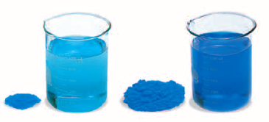
How much are you dissolving
Concentration- is the amount of solute dissolved in a solvent (grams per milliliter g/mL)
Dilute= Less solute
Concentrated = More Solute

Slide 23
SPEED IT UP
3 ways to make particles dissolve faster
1- Mixing- Stirring or shaking causes particles to separate and spread quickly.
2- Heating- Move more/faster and separate quickly
3- Crushing- Increases the amount of contact between the solute and solvent causing better mixing.

Slide 24
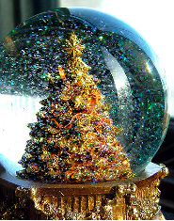
Suspensions
A Suspension is a mixture where the particles are mixed in a solvent, but they DO NOT DISSOLVE

Slide 25
Examples of suspensions
Polluted air- think about dust that floats around in the air.
The dust particles are too big to fully mix and combine with air/gas particles
Salad dressing is another examples

Slide 26
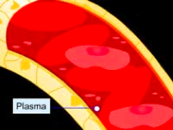
BLOOD
Blood is a special type of suspension
It consists or red and white blood cells and platelets (actually suspended in plasma)
The solution- is water
The plasma is 9-% water and 10 % particles (sugars, vitamins and charged particles)

Slide 27
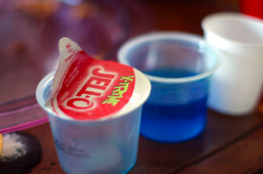
Colloids
A colloid is a mixture in which the particles are spread throughout the solvent, but cannot settle.
The particles are a whole lot smaller than those in a suspension
Also called emulsions
Examples: slime, ice cream
jello

