Slide 1
Classifying forces

Slide 2
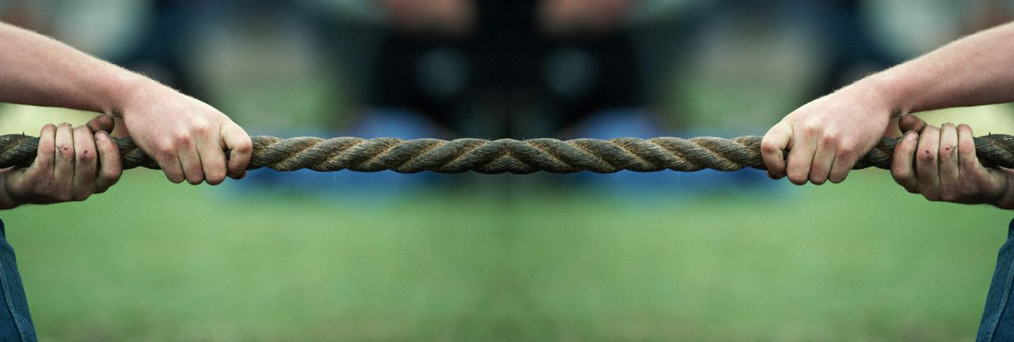
What is a force
A force is a push or a pull

Slide 3
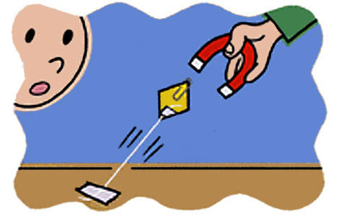
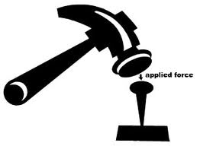
2 types of forces
Contact Forces
Applied force
Spring force
Frictional force
Tensional force
Normal force
Air resistance
Distant forces
Gravitational force (gravity)
Electrical force
Magnetic force

Slide 4
Contact forces Chart
Type of force | Abbreviation | Definition
Applied | F_{app} | Force that is applied to an object by a person or another object.
Normal | F_{norm} | A support force exerted upon an object that is in contact with another stable object
Friction | F_{fric} | Is a force exerted by a surface as an object moves across it or makes (sliding) an effort to move across it (static)
Tension | F_{tens} | Force that is transmitted through a string, rope, cable or wire when it is pulled tight by forces acting from opposite ends.
Spring | F_{spring} | Force exerted by a compressed or stretched spring upon any object that is attached to it

Slide 5
Gravity
Gravity force- attraction to between two objects.
Also known as weight
F_{grav}
All objects upon earth experience a force of gravity that is directed downward towards the center of the earth.

Slide 6
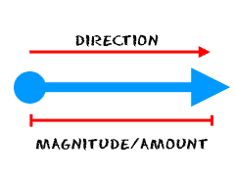
Forces are Vectors
Force has both size and direction
SIZE of the vector = Magnitude (how strong the force will be)
DIRECTION of the vector= which direction the force is applied on the object.

Slide 7
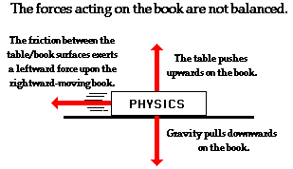
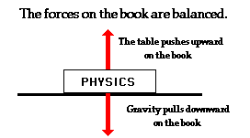
Balanced and unbalanced forces

Slide 8
Balanced Forces
Net force- when all the forces are combined
Net force= 0, the forces acting on the object is zero
Net force= 0= blanced= No Motion

Slide 9
Unbalanced forces
ONLY an unbalanced force can change the motion of an object.
Unbalanced forces cause motion (acceleration)

Slide 10
Free Body Diagrams
Use force vectors to illustrate the forces acting upon an object or body.
Show the magnitude and the direction of the force acting on objects.

